Slide 1
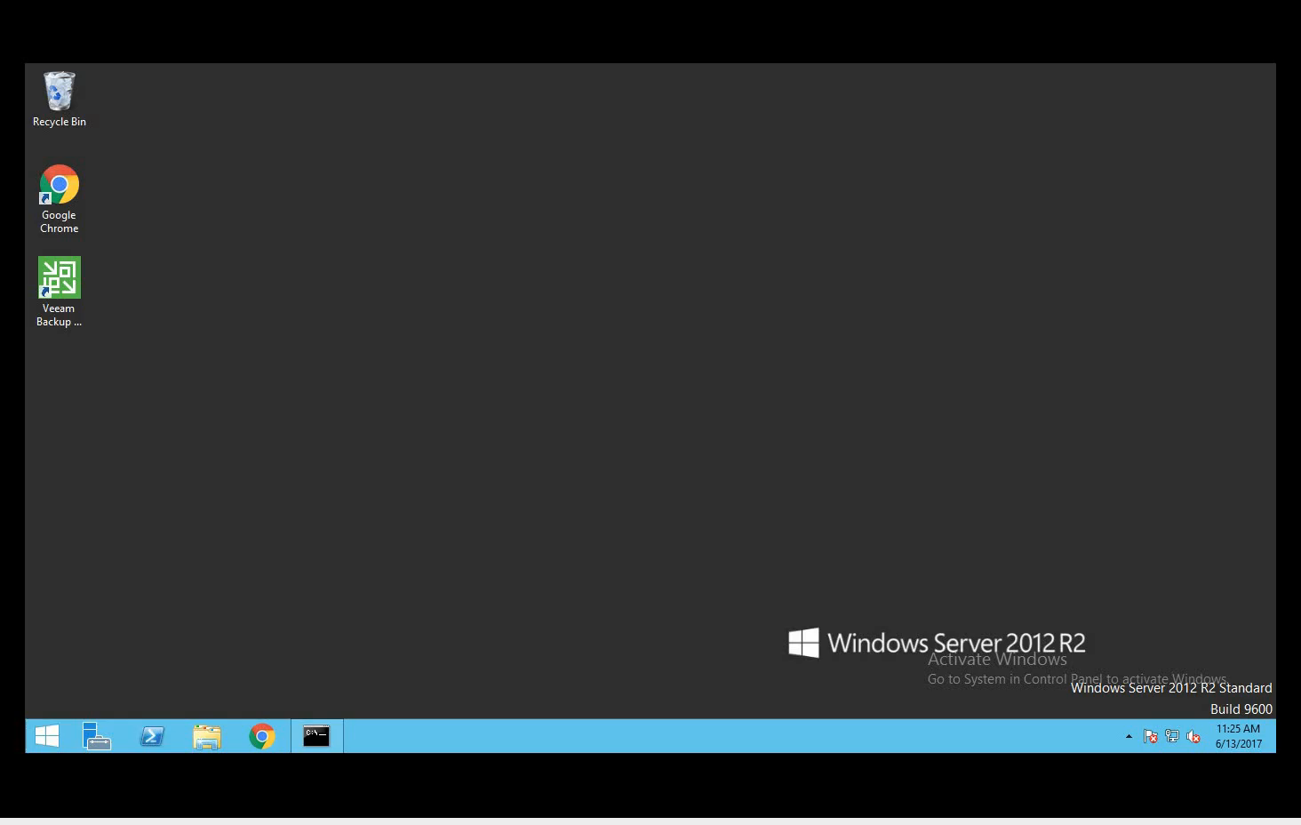
Demo vm infrastructure recovery
Notes:
-An end user accidentally deletes an important Virtual Machine hosted on Hyper-V.
-She realizes her mistake and reaches out to IT who examines the logs in the ArcSight Command Center.
-Thankfully, the Virtual Machines have been routinely backed up using Veeam Backup & Replication.
-IT is able to restore the Virtual Machine from the backup in Veeam Backup & Replication.

